Slide 1

CISC450 Computer Networks
Lesson 0
Introduction
Some figures courtesy of
William Stallings

Slide 2
Schedule
Introduction
Syllabus
Introduction to Networks

Slide 3
Introduction
John K. Scoggin, Jr.
Systems Engineering Consultant
Conectiv, Inc.
Adjunct Assistant Professor, CIS Dept
University of Delaware
Phone: (302) 451-5000 (Conectiv)
(302) 831-1028 (UDel)
Email: scoggin@cis.udel.edu

Slide 4

Office Hours
1:00 – 1:45 PM Tuesday and Thursday
Smith 101B
Other hours by appointment
Can sometimes be found on campus during the weekend; call/email first!

Slide 5
Syllabus
Electronic copy is available on the class website:
http://www.cis.udel.edu/~scoggin

Slide 6


What’s with the Owl?
Important points
You will see this material again

Slide 7
Where CISC450 Fits
CISC451
Data Compression
CISC360
Comp Arch
CISC450
Comp Networks
CISC452
Telecom Systems
CISC361
Oper Systems
CISC458
Applied Networks

Slide 8
What You Will Learn in the Series
LOTS of terminology (TLA/ETLA)
Basics of communications
Networking and network technologies
Internetworking
Telephony and Wide Area Networks
Basic network design practices

Slide 9
What You Will NOT Learn
Network operating systems
How to configure/operate equipment in a vendor-specific way
How to design and implement network software

Slide 10
What is a Computer Network?
A collection of transmission hardware and facilities, terminal equipment, and protocols
Provides communications that are
  Reliable
  Efficient
  Error-free

Slide 11
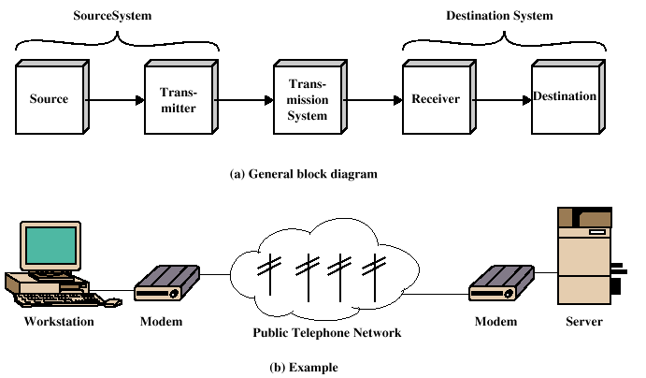
Data Communications Model

Slide 12
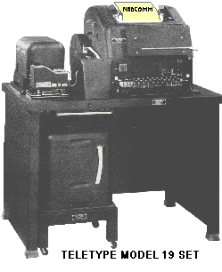
Early Networks
Primarily terminal-to-terminal communications
Message-oriented
Replaced manual telegraphy (Western Union)
Stock tickers

Slide 13
Development of Computer Networks
Man-Machine Communications
Semi-Automatic Ground Environment (SAGE)
  Deployed in 1963
  22 Directional Centers, 3 Combat Centers
  Remote RADAR sites interconnected to DC’s via telephone lines
  Fault-tolerant computers w/real-time graphical display consoles (AN/FSQ-7)
  Vacuum tube technology (600 tons of A/C, 1 megawatt of power!

Slide 14
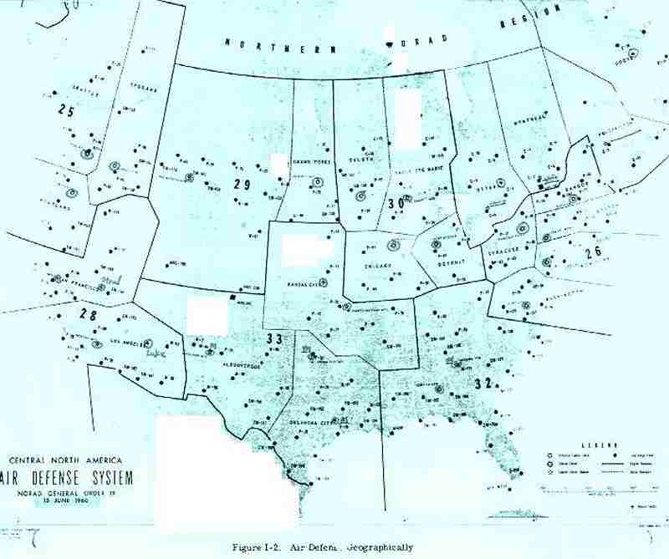
SAGE Network

Slide 15
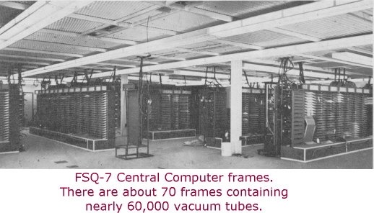
SAGE AN/FSQ-7 CPU

Slide 16
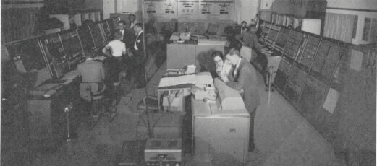
AN/FSQ-7 Maintenance Consoles

Slide 17
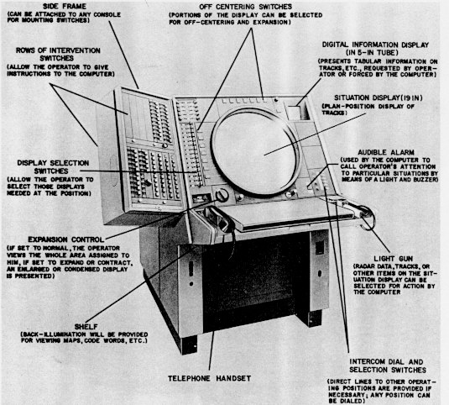
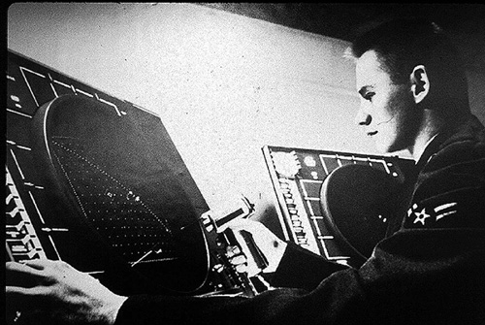
SAGE Display Console

Slide 18
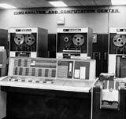
Civilian Applications
Airline Reservation Systems
  SABRE – American Airlines
    Early 1960’s
    Based upon IBM mainframes (7090 initially)
    Specialized operating systems, terminal equipment

Slide 19
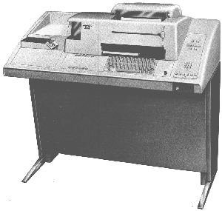
Civilian Applications
Timesharing (1968-74)
  MULTICS (MIT/GE/Bell)
  DEC PDP-10
  XDS 940
  Burroughs 5500/6500
Based upon Teletype technology (10-30 chars per second) initially
Dialed lines

Slide 20
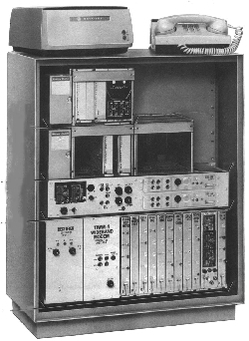
High-speed Data Communications
NASA Space Network
AUTODIN
300 bits/second and up!
Bell 303 50 Kbps Modem

Slide 21
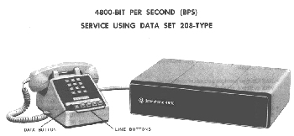
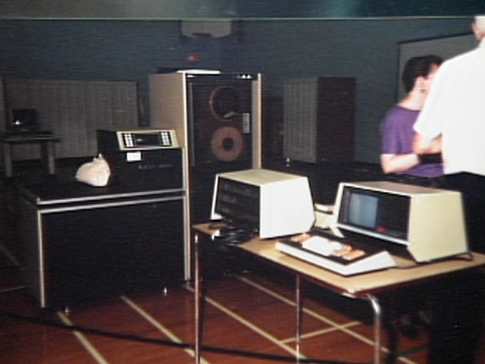
Characteristics of Early Networks
Low speed
Error-prone
Vendor-specific
Text-oriented
Analog transmission

Slide 22
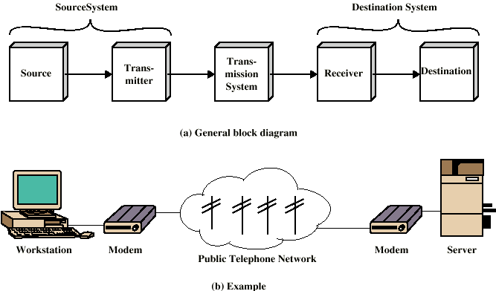
Data Communications Model

Slide 23
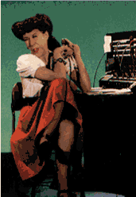
Circuit Switched Networks
Think of the Public Switched Telephone Network (PSTN)
  Connection-oriented
  Reliable
  One-to-one or limited one-to-many
  Routing decided at call setup time
  QOS?

Slide 24
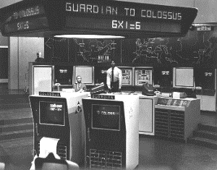
Packet Switched Networks
Routing decisions made dynamically
  Datagrams
  Reliable/unreliable
  Connection-oriented / Connectionless
  QOS?

Slide 25
Protocols
Used for communications between entities in a system
Must speak the same language
Entities
  User applications
  e-mail facilities
  terminals
Systems
  Computer
  Terminal
  Remote sensor

Slide 26
Key Elements of a Protocol
Syntax
  Data formats
  Signal levels
Semantics
  Control information
  Error handling
Timing
  Speed matching
  Sequencing

Slide 27
Protocol Architecture
Task of communication broken up into modules
For example file transfer could use three modules
  File transfer application
  Communication service module
  Network access module

Slide 28
Standards
Required to allow for interoperability between equipment
Advantages
  Ensures a large market for equipment and software
  Allows products from different vendors to communicate
Disadvantages
  Freeze technology
  May be multiple standards for the same thing

Slide 29
Standards Organizations
Internet Society
ISO
ITU-T (formally CCITT)
ATM forum

Slide 30
OSI Protocol Suite
CCITT Standard
ISO Reference Model
  Heavily referenced
  Rarely implemented
What’s magic about 7 layers?
Heavily influenced by PTT’s
Originally connection-oriented
Applications still have usage
(X.400,X.500,FTAM)
7
Application
Application
Presentation
Presentation
Session
Session
Transport
Transport
Network
Network
Data Link
Data Link
1
Physical
Physical

Slide 31
TCP/IP Protocol Suite Overview
Definitions:
  TCP/IP Protocol Suite, TCP/IP Layers
  Qualities of Service
Outline of the main protocols
  Internet Protocol (IP)
  User Datagram Protocol (UDP)
  Transmission Control Protocol (TCP)
Brief sketch of “helper protocols”:
  ARP, RARP, ICMP, IGMP
TCP/IP Internetworking
  from simple to complex...
TCP/IP Bureaucracy
  TCP/IP standards: “RFC’s”
  Administration of the Internet (org chart)

Slide 32
The TCP/IP Protocol Suite
Allows computers of many sizes, vendors and operating systems to communicate with each other
History:
  1960’s: started as gov’t financed research project
  1990’s: most widely used form of networking
An Open System by the following definition:
  The definition of the protocol suite and many of its implementations are publicly available at little or no charge.
Forms the basis for the Internet (capital “I”)
  (a WAN of > 1 million computers that spans the globe)
Notes:
St94, p. 1

Slide 33
TCP/IP Layers
Networking protocols developed in layers
A protocol suite such as TCP/IP is a combination of protocols at different layers.
OSI has seven layers, but in TCP/IP, we usually consider just four of these...

Slide 34

The “four” TCP/IP layers
server
FTP
FTP
client
Application
FTP
server
(What humans care about)
Transport
TCP
TCP
(End-to-end Communications)
Network
IP
IP
(routing)
IP
IP
Link
Ethernet
Driver
Ethernet
Driver
Ethernet
Driver
Ethernet
Driver
(Device Driver and Interface Card)

Slide 35
“TCP/IP Protocol Suite”
IP
DNS
FTP
Telnet
RIP
NNTP
ARP
whois
IGMP
TCP/IP protocol suite
SMTP
TFTP
UDP
OSPF
TCP
RARP
SNMP
NTP
and many more...
BOOTP
finger
ICMP
The TCP/IP Protocol Suite is a combination of many protocols, not just TCP and IP.
Alternative names:
Internet Protocol Suite
U.S. Department of Defense (DoD) Protocol Suite

Slide 36
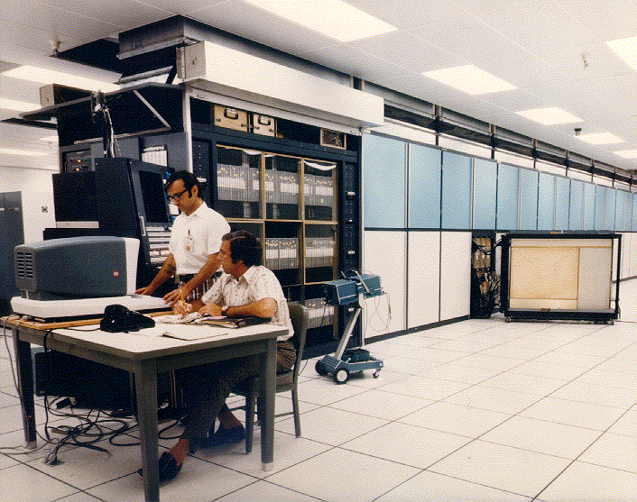
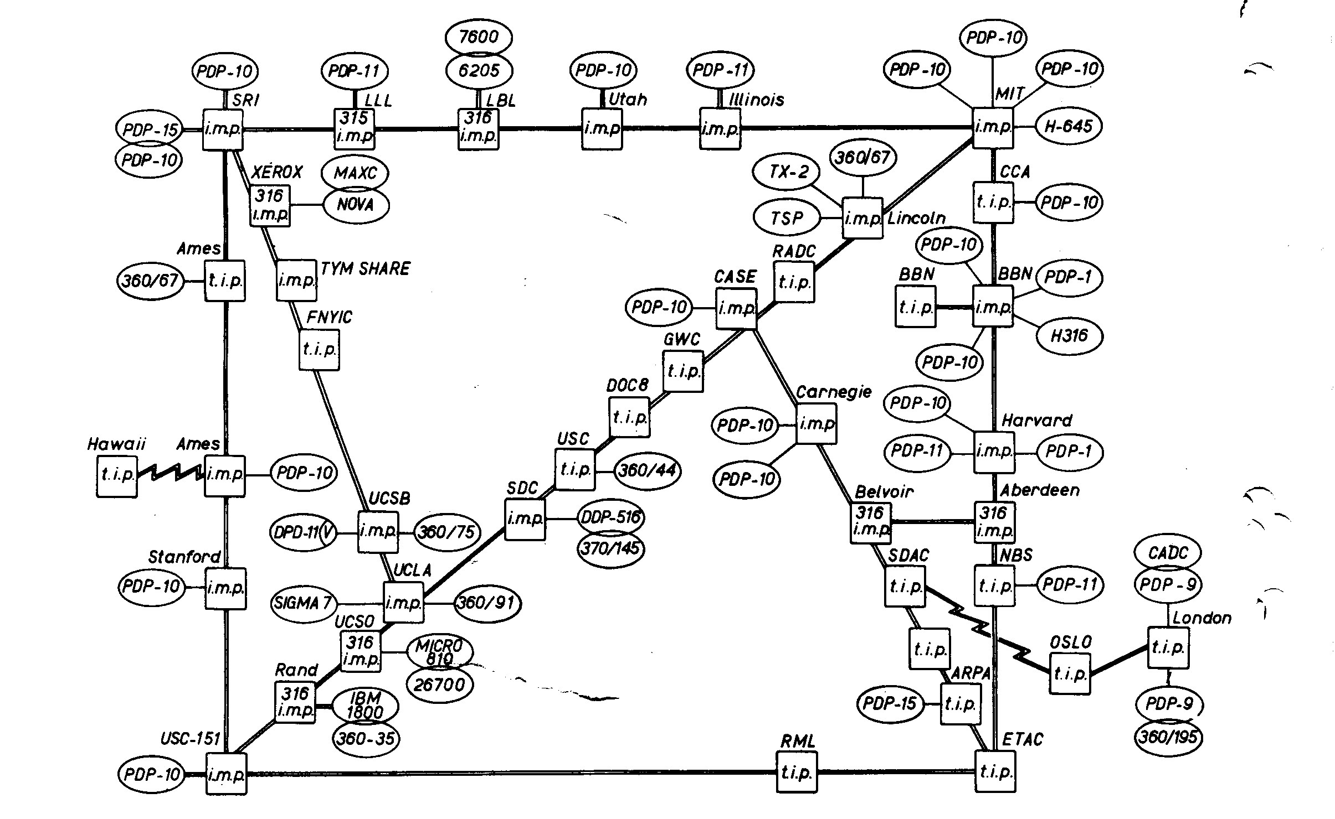
The Internet
Developed in 1970’s to foster sharing of computer resources (ARPAnet) / Fault Tolerant
Suite of protocols
  Reliable
  Scalable
  Vendor-independent
NSFNET Implemented
on 50Kbps lines

Slide 37
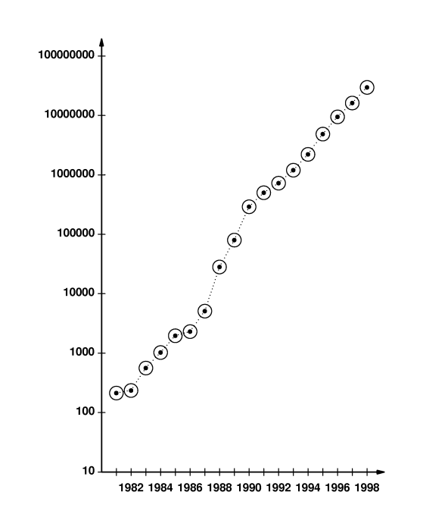
Internet Growth
Estimated number of hosts
Doubling in size every 6 to 9 months

Slide 38
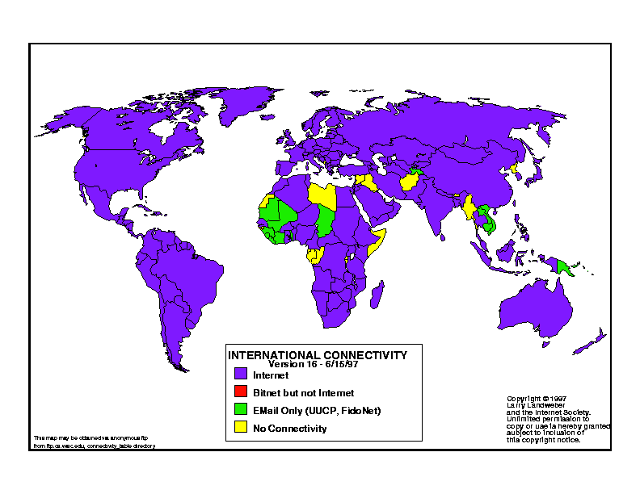
Structure of the Internet
Decentralized
No single point of control
Dependency on RFCs and good will
"We reject: kings, presidents and voting. We believe in: rough consensus and running code.“ – Dr. David Clark, MIT (GNOF)

Slide 39
For next class:
Read Chapters 1 and 2 (if you haven’t already)

